Slide 1
BRITISH AIRWAYS CUSTOMERS BOOKING PREDICTIVE MODEL.
BY: BALA MAIRIGA ABDULJALIL
17TH , APRIL; 2023.

Slide 2
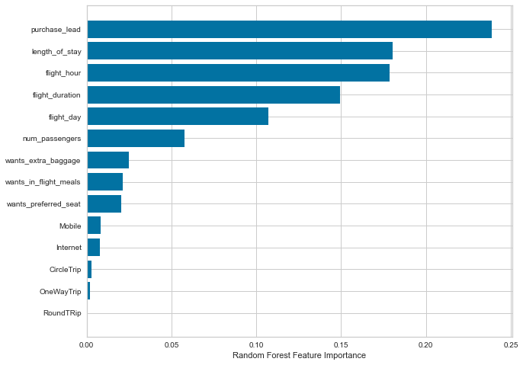
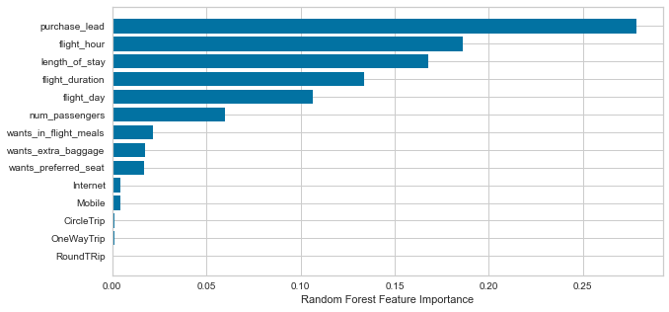
CUSTOMER BOOKING PREDICTIVE MODEL The model has an accuracy of 84.4 after training the data set with random forest classifier. However Purchase_lead, fight_hour, length_of_day,flight_duration and flight_day are the top five importance feature within the data set.
v

